Slide 1
Lecture 5-1
Logistic (regression) classification
Sung Kim <hunkim+mr@gmail.com>
http://hunkim.github.io/ml/

Slide 2
Acknowledgement
Andrew Ng’s ML class
https://class.coursera.org/ml-003/lecture
http://www.holehouse.org/mlclass/ (note)
Convolutional Neural Networks for Visual Recognition
http://cs231n.github.io/
http://cs231n.stanford.edu/
TensorFlow
https://www.tensorflow.org
https://github.com/aymericdamien/TensorFlow-Examples

Slide 4
Regression (HCG)
H
C
G
x1 (hours) | x2 (attendance) | y (score)
10 | 5 | 90
9 | 5 | 80
3 | 2 | 50
2 | 4 | 60
11 | 1 | 40
http://www.cse.iitk.ac.in/users/se367/10/presentation_local/Binary%20Classification.html

Slide 5


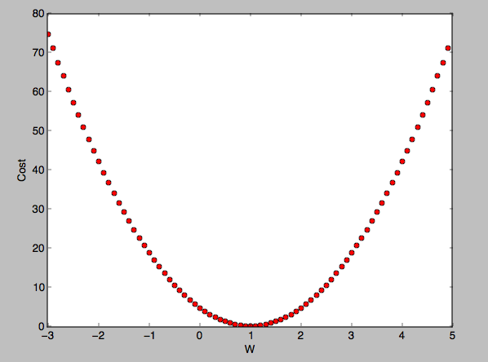

Regression
Hypothesis:
Cost:
Gradient decent:
x1 (hours) | x2 (attendance) | y (score)
10 | 5 | 90
9 | 5 | 80
3 | 2 | 50
2 | 4 | 60
11 | 1 | 40
http://www.cse.iitk.ac.in/users/se367/10/presentation_local/Binary%20Classification.html

Slide 6
Classification
Spam Detection: Spam or Ham
Facebook feed: show or hide
Credit Card Fraudulent Transaction detection: legitimate/fraud
http://www.cse.iitk.ac.in/users/se367/10/presentation_local/Binary%20Classification.html

Slide 7
0, 1 encoding
Spam Detection: Spam (1) or Ham (0)
Facebook feed: show(1) or hide(0)
Credit Card Fraudulent Transaction detection: legitimate(0) or fraud (1)
http://www.cse.iitk.ac.in/users/se367/10/presentation_local/Binary%20Classification.html

Slide 8
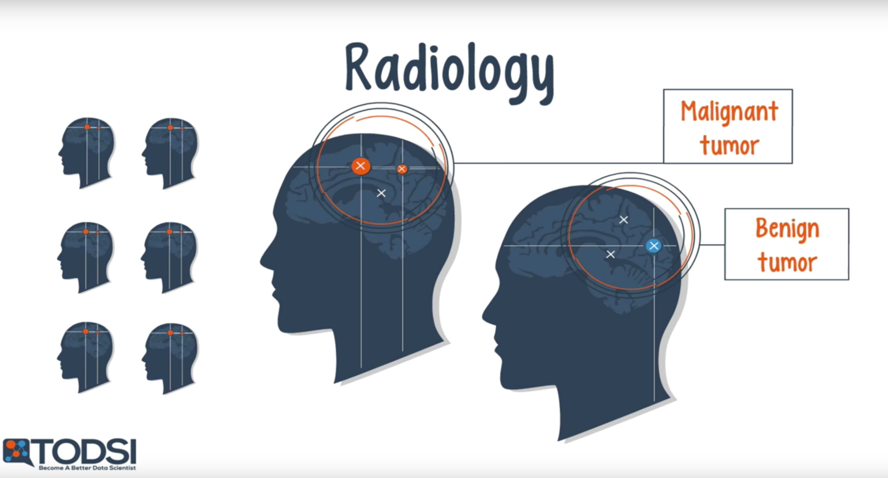
https://www.youtube.com/watch?v=BmkA1ZsG2P4

Slide 9
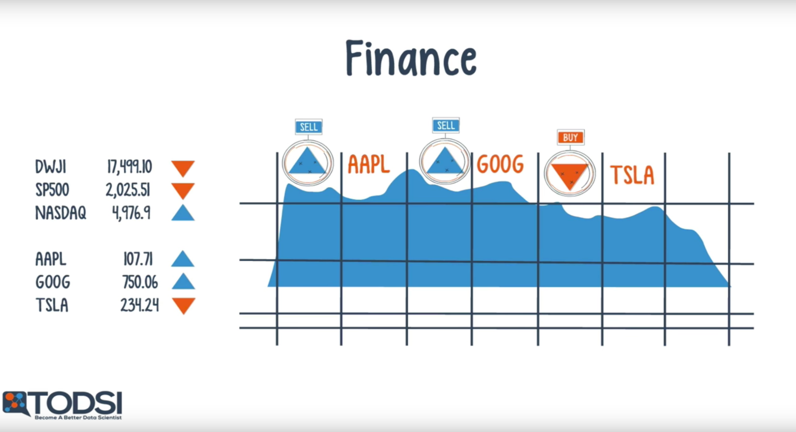
https://www.youtube.com/watch?v=BmkA1ZsG2P4

Slide 10
Pass(1)/Fail(0) based on study hours
1 (pass)
0 (fail)
hours

Slide 11
Linear Regression?
1 (pass)
0 (fail)
hours

Slide 12

Linear regression
We know Y is 0 or 1
Hypothesis can give values large than 1 or less than 0
http://www.holehouse.org/mlclass/06_Logistic_Regression.html

Slide 13
Logistic Hypothesis

Slide 14
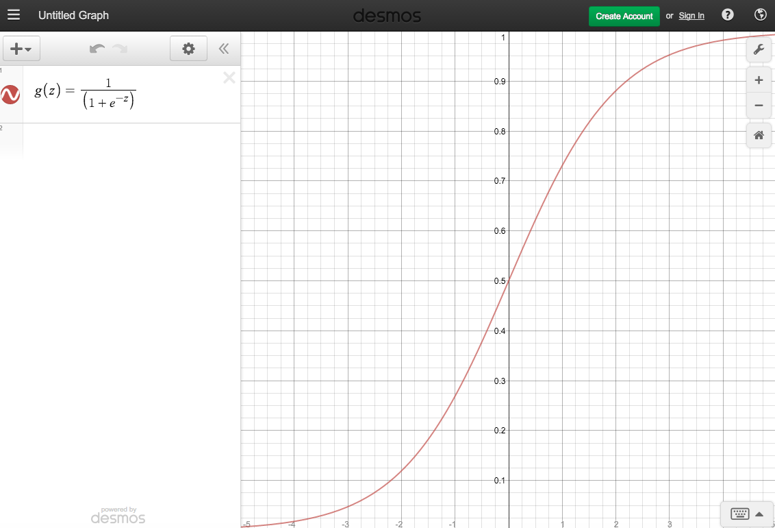
logistic function,
sigmoid function.
sigmoid:
Curved in two directions,
like the letter "S",
or the Greek ς (sigma).

Slide 15

Logistic Hypothesis

